Slide 1
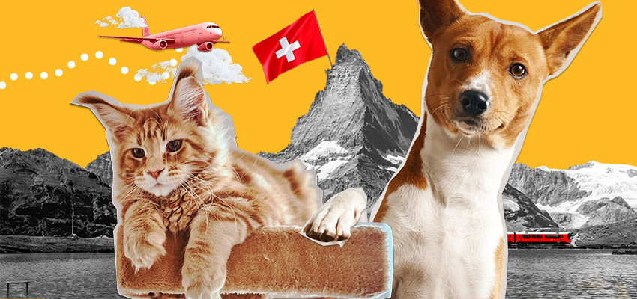
Across the border with a dog or cat

Slide 2
Geneva
Zürich

Slide 4
